Slide 1
Red-Black Trees
6
v
3
8
z
4

Slide 2
From (2,4) to Red-Black Trees
A red-black tree is a representation of a (2,4) tree by means of a binary tree whose nodes are colored red or black
In comparison with its associated (2,4) tree, a red-black tree has
same logarithmic time performance
simpler implementation with a single node type
4
3 5
2 6 7
4
5
3
6
OR
3
5
2
7

Slide 3
Red-Black Trees
A red-black tree can also be defined as a binary search tree that satisfies the following properties:
Root Property: the root is black
External Property: every leaf is black
Internal Property: the children of a red node are black (red rule)
Depth Property: all the leaves have the same black depth (path rule)
(Question) How is balancing enforced here?
9
4
15
2
6
12
21
7
Notes:
모두가 black node이면, → obviously balanced, 모든 path가 같은 height이어야 한다. → 하지만, 너무 strict하여, 제한이 많음.
중간에 red node라는 것을 넣어서, flexibility를 주도록 하자는 것이 idea
Red node를 함부러 넣을 수는 없다. 그 이유는 red를 넣는 순간, black이 다음에 와야하고, 그것이 path rule을 깰 수 있기 때문이다.

Slide 4
Red Black Tree?
19
12
35
50
0
75
-10
135
-5
-8
100
-6
80
Notes:
No. Depth property가 성립이 되지 않는다.

Slide 5
Red Back Tree?
19
12
35
3
16
0
What if we attach a child to node 0?
Notes:
이것은 RB tree이다. 하지만, 0에 node를 붙이면, black이어야 하고, 그러면, path rule이 깨진다.

Slide 6
Implications
Root Property: the root is black
External Property: every leaf is black
Internal Property: the children of a red node are black (red rule)
Depth Property: all the leaves have the same black depth (path rule)
1. If a red node has any children, it must have two children and they must be black
Why? Depth property
2. If a black node has only one “real” child then it must be a ”last” red node
If the child is black?
If the child is not the last red?
(Question) How is balancing enforced in R-B tree?
Notes:
1번: 1개만 가지고 있으면, depth property가 깨진다.
2번:

Slide 7
Intuition about “rough balancing”
The longest path <= 2 * the shortest path
Rough balancing → guarantees log(n) height
Why?
From “red rule” and “path rule” shortest path = only black nodes longest path = inserting a red node between two black nodes
Root Property: the root is black
External Property: every leaf is black
Internal Property: the children of a red node are black (red rule)
Depth Property: all the leaves have the same black depth (path rule)

Slide 8
Height of a Red-Black Tree
Theorem: A red-black tree storing n entries has height O(log n)
Proof:
Omitted
The search algorithm for a binary search tree is the same as that for a binary search tree
By the above theorem, searching in a red-black tree takes O(log n) time

Slide 9
Insertion

Slide 10
Insertion
To perform operation put(k, o), we execute the insertion algorithm for binary search trees and color red the newly inserted node z unless it is the root
We preserve the root, external, and depth properties
If the parent v of z is black, we also preserve the internal property and we are done
Else (v is red ) we have a double red (i.e., a violation of the internal property), which requires a reorganization of the tree
Goal: Removing double read without breaking the depth property
Example where the insertion of 4 causes a double red:
6
6
v
v
3
8
3
8
z
z
4

Slide 11
Remedying a Double Red
Consider a double red with child z and parent v, and let w be the sibling of v
Case 1: w is black
Viewpoint The double red is an incorrect replacement of a 4-node
Restructuring: we change the 4-node replacement
Case 2: w is red
Viewpoint The double red corresponds to an overflow
Recoloring: we perform the equivalent of a split
w
4
v
w
4
v
2
z
7
2
z
7
6
6
4 6 7
2 4 6 7
.. 2 ..

Slide 12
Restructuring
A restructuring remedies a child-parent double red when the parent red node has a black sibling
It is equivalent to restoring the correct replacement of a 4-node
The internal property is restored and the other properties are preserved
z
4
6
w
v
v
2
7
4
7
z
w
6
2
4 6 7
4 6 7
.. 2 ..
.. 2 ..

Slide 13
Restructuring (cont.)
There are four restructuring configurations depending on whether the double red nodes are left or right children
2
6
6
2
6
2
4
4
4
4
2
6
4
2
6

Slide 14
Recoloring
A recoloring remedies a child-parent double red when the parent red node has a red sibling
The parent v and its sibling w become black and the grandparent u becomes red, unless it is the root
It is equivalent to performing a split on a 5-node
The double red violation may propagate to the grandparent u
w
4
v
w
4
v
2
z
7
2
z
7
6
6
… 4 …
2 4 6 7
2
6 7

Slide 15
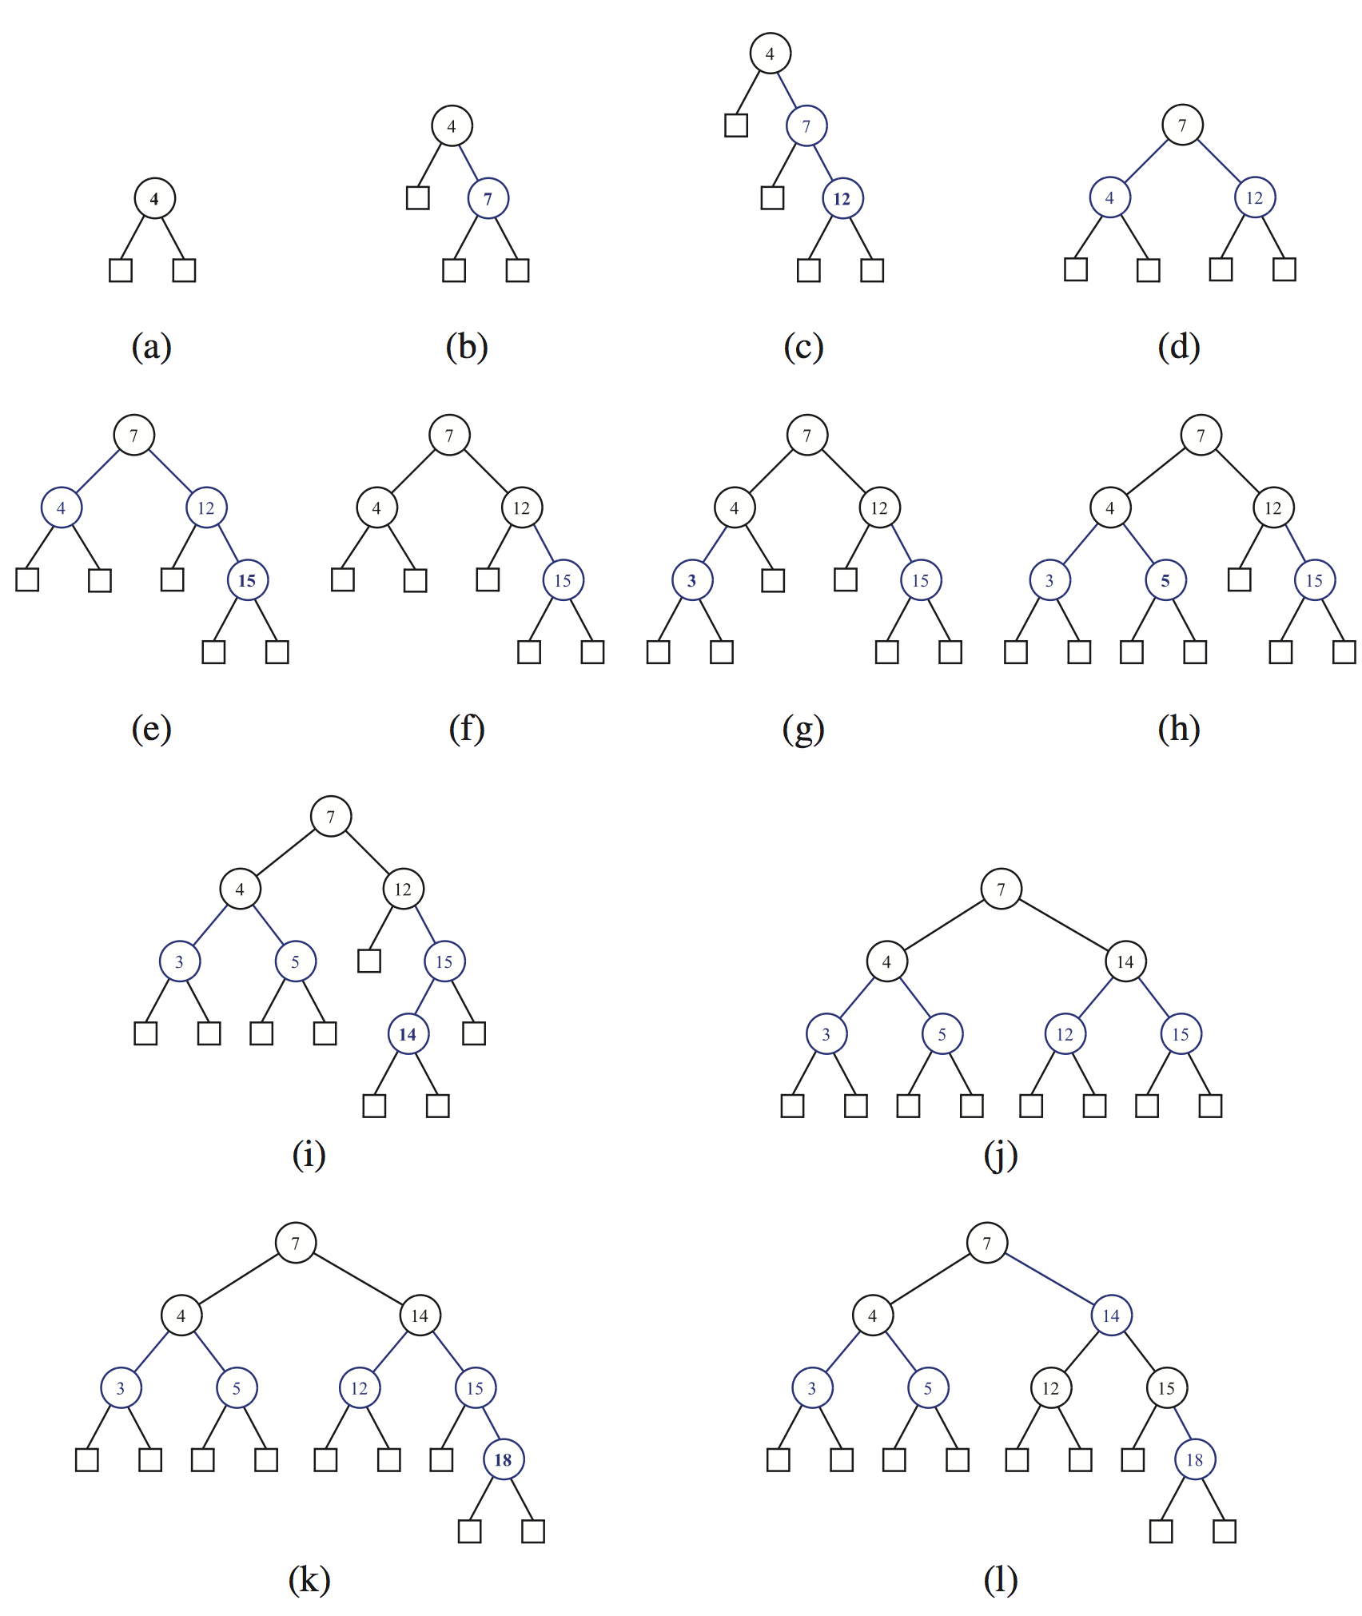
w
v
RST
w
v
RCL
w
v
RST
w
v
RCL

Slide 16
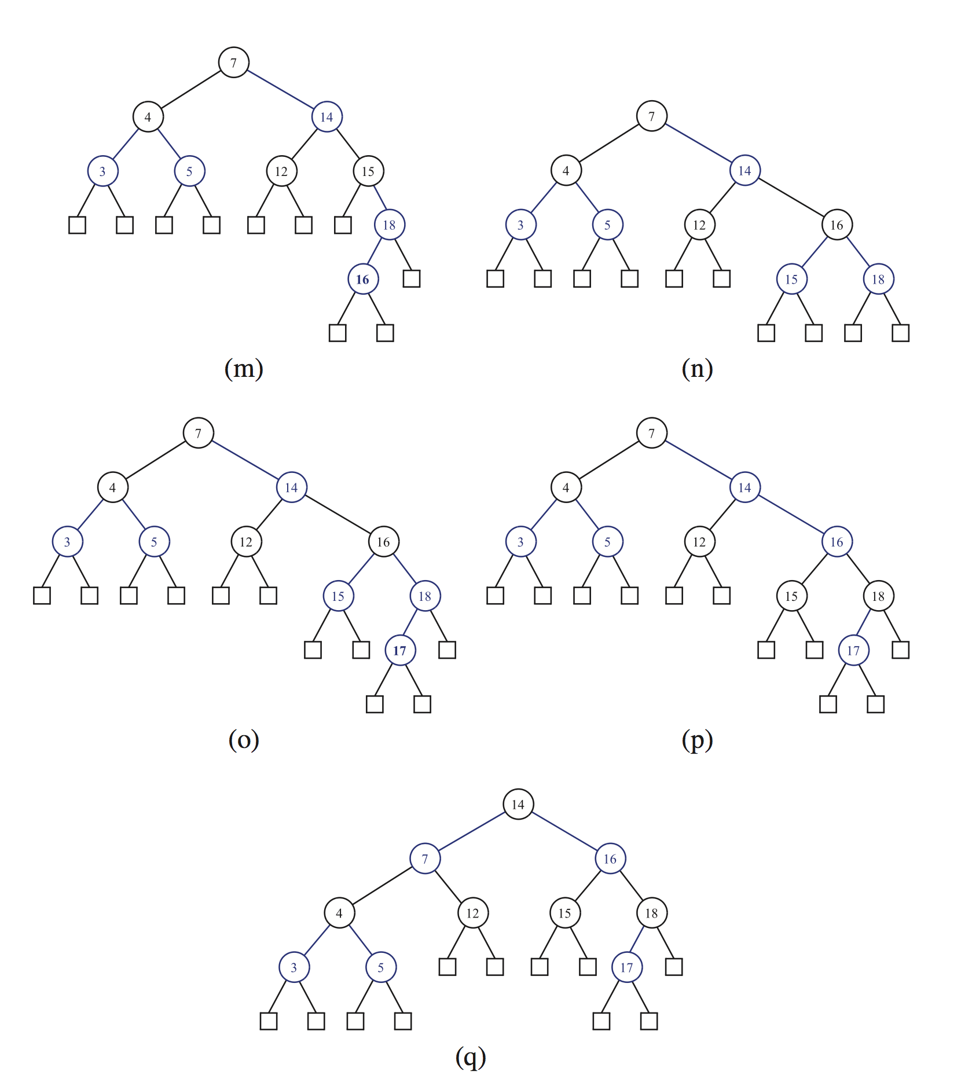
w
v
RST
w
v
RCL
RST

Slide 17
Analysis of Insertion
Algorithm put(k, o)
1. We search for key k to locate the insertion node z
2. We add the new entry (k, o) at node z and color z red
3. while doubleRed(z)
if isBlack(sibling(parent(z)))
z ← restructure(z)
return
else { sibling(parent(z) is red }
z ← recolor(z)
Recall that a red-black tree has O(log n) height
Step 1 takes O(log n) time because we visit O(log n) nodes
Step 2 takes O(1) time
Step 3 takes O(log n) time because we perform
O(log n) recolorings, each taking O(1) time, and
at most one restructuring taking O(1) time
Thus, an insertion in a red-black tree takes O(log n) time

Slide 18
RB-Tree: Deletion

Slide 19
Deletion: Example 1
To perform operation erase(k), we first execute the deletion algorithm for binary search trees
10
10
10
5
30
5
35
30
-5
7
20
38
-5
7
20
38
null
null
null
null
null
null
35
null
null
null
null
null
null
null
35
null
delete 30
null
null
Copy inorder successor
null
null
10
Just delete the copied 35, and color the remaining node in black. Then, we are done.
Implication:
If the node to be deleted is red, removing it is fine
5
35
-5
7
20
38
null
null
null
null
null
null
null
null

Slide 20
Deletion: Example 2
To perform operation erase(k), we first execute the deletion algorithm for binary search trees
10
10
5
30
5
32
-5
7
20
38
-5
7
20
38
null
null
null
null
null
null
32
41
null
null
null
null
null
null
32
41
delete 30
null
35
null
null
Copy inorder successor
null
35
null
null
null
null
null
null
10
Just delete the copied 32, and color 35 with black.
Implication: For a node (with a red child) to be deleted, delete it and change the red child’s color.
(35: -1 first and +1 second. So no change)
5
32
-5
7
20
38
null
null
null
null
null
null
35
41
null
null
null
null
Notes:
이것을 double red를 해결하는 방식으로 하지 않는 이유는? 상황이 다르다. Double red로 볼 수 없다. 35쪽에 이미, depth rule이 깨져있다.

Slide 21
Deletion: Example 3
What about deleting a node with a black child?
10
20
-10
30
-10
30
null
null
20
38
null
null
20
38
null
null
null
null
null
null
null
null
Delete 10
Copy inorder successor
20
-10
30
Delete 20.
Problem: A path of only 2 blacks
null
null
null
38
null
null
Regard this as “double black nodes”

Slide 22
Deletion
To perform operation erase(k), we first execute the deletion algorithm for binary search trees
Enough to consider the removal of an entry at a node with an external child (To remove a node with both internal children, we first copy the inorder successor, and then …)
Notations
v : the internal node removed,
“myself”
w : the external node removed,
“my lonely child”
r : the sibling of w
“my other child”
x : the parent of v
“my father”
Delete 30
10
5
30
x
-5
7
20
38
v
null
null
null
null
null
null
32
41
w
r
null
35
null
null
null
null

Slide 23
Questions
How to handle “double black nodes”
Are there some cases in handling those? Yes
Are you ready for ”cases”?
It’s really, really complex, but if you concentrate, then you can follow it.

Slide 24
Deletion: Algorithm Overview (1)
First, remove v and w, and make r a child of x
If either of v or r was red, we color r black and we are done (Examples 1 and 2)
Else (v and r were both black) we color r double black, which is a violation of the internal property requiring a reorganization of the tree (Examples 3)
10
delete 30
5
30
-5
7
20
38
null
null
null
null
null
null
35
null
null
null
10
5
35
x
-5
7
20
38
null
null
null
null
null
null
35
v
null
null
null
r
w
10
5
35
-5
7
20
38
null
null
null
null
null
null
null
null

Slide 25
Deletion: Algorithm Overview (2)
First, remove v and w, and make r a child of x
If either of v or r was red, we color r black and we are done (Examples 1 and 2)
Else (v and r were both black) we color r double black, which is a violation of the internal property requiring a reorganization of the tree (Examples 3)
delete 30
10
5
30
-5
7
20
38
null
null
null
null
null
null
32
41
null
35
null
null
null
null
10
5
32
x
-5
7
20
38
v
null
null
null
null
null
null
32
41
w
35
r
null
null
null
null
null
10
5
32
-5
7
20
38
null
null
null
null
null
null
35
41
null
null
null
null

Slide 26
Deletion: Algorithm Overview (2)
First, remove v and w, and make r a child of x
If either of v or r was red, we color r black and we are done (Examples 1 and 2) (Let’s call this Case 0)
Else (v and r were both black) we color r double black, which is a violation of the internal property requiring a reorganization of the tree (Examples 3)
Notations after removing v and w
y: sibling of r
z: child of y
We now divide the cases, depending of the color of y and z
Notes:
R이 double black이라는 것을 강조한다.

Slide 27
Recall: Example 3. Notations again!
What about deleting a node with a black child?
10
20
x
-10
30
-10
30
v
null
null
20
38
null
null
20
38
null
null
null
null
null
null
null
null
w
r
20
Delete 10
Copy inorder successor
x
-10
30
r
y
Delete 20.
Problem: A path of only 2 blacks
null
null
null
38
z
null
null
Regard this as “double black nodes”

Slide 28
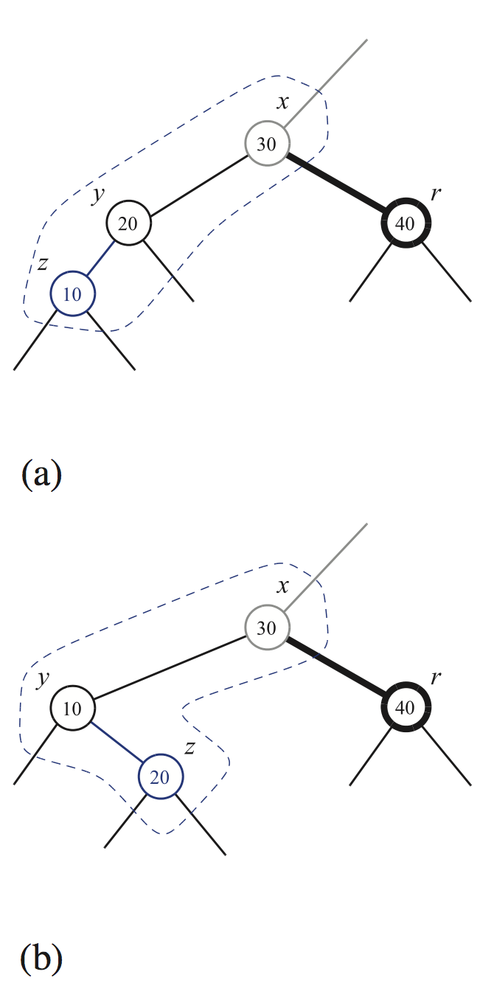
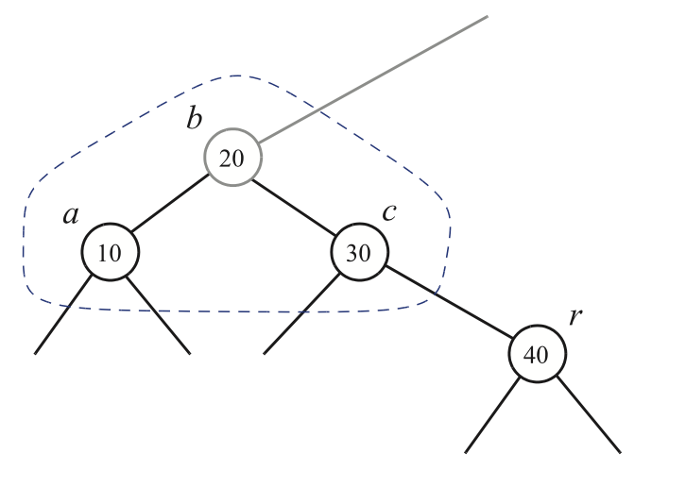
Handling Double Black Nodes: Case 1
Case 1: The sibling y of r is black, and has a red child z
We perform a restructuring, and we are done
z is the left child
z is the right child
Double black node solved?
Notes:
Double black node가 해결된 이유는?

Slide 29
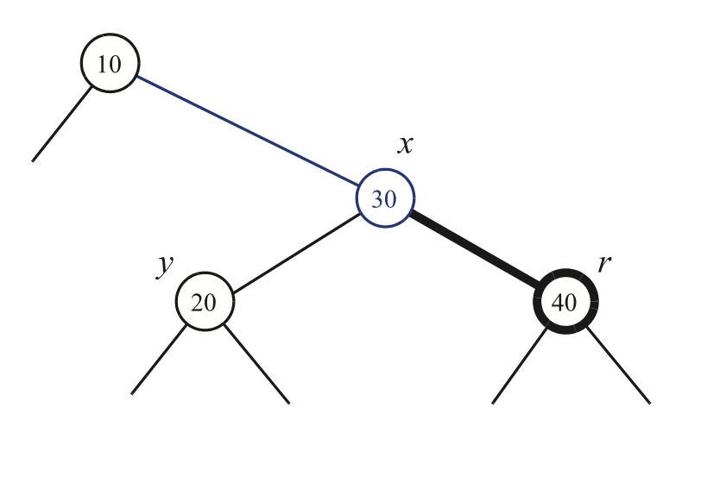
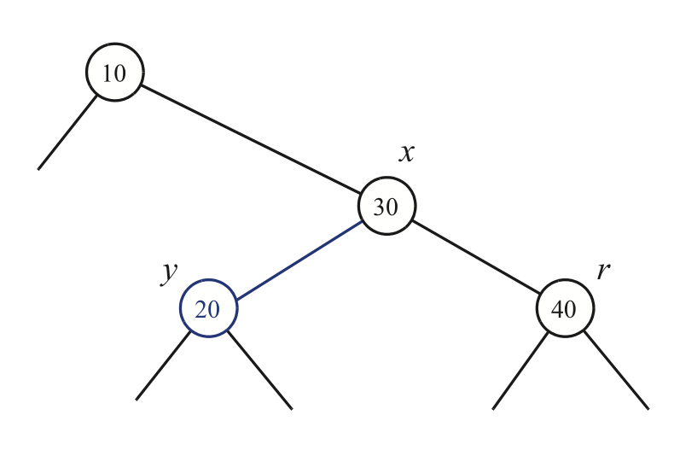
Handling Double Black Nodes: Case 2
Case 2: The sibling y of r is black, and y’s both children are black
We perform a recoloring
Case 2-1: x (r’s parent) is red
Color x black and color y red

Slide 30
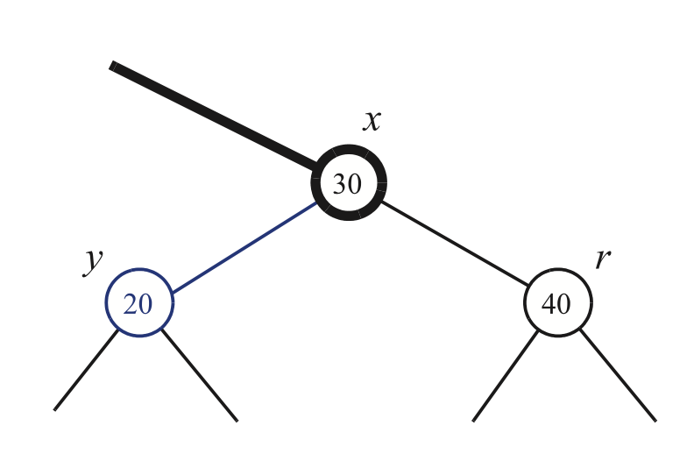
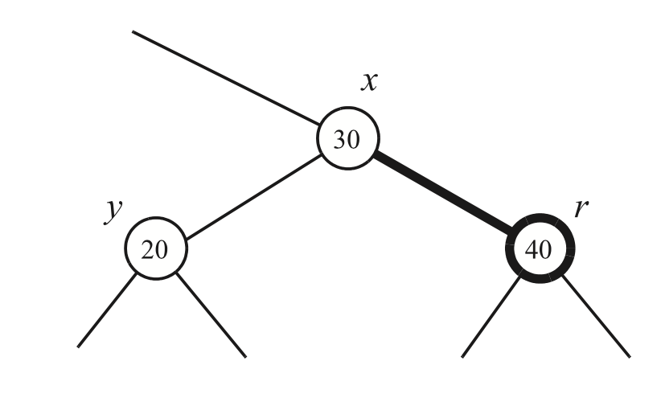
Handling Double Black Nodes: Case 2
Case 2: The sibling y of r is black, and y’s both children are black
We perform a recoloring
Case 2-2: x (r’s parent) is black
Color y red (which solves r’s double black),
and make x “double black”
(propagates the double black up), then reconsider the cases for x

Slide 31
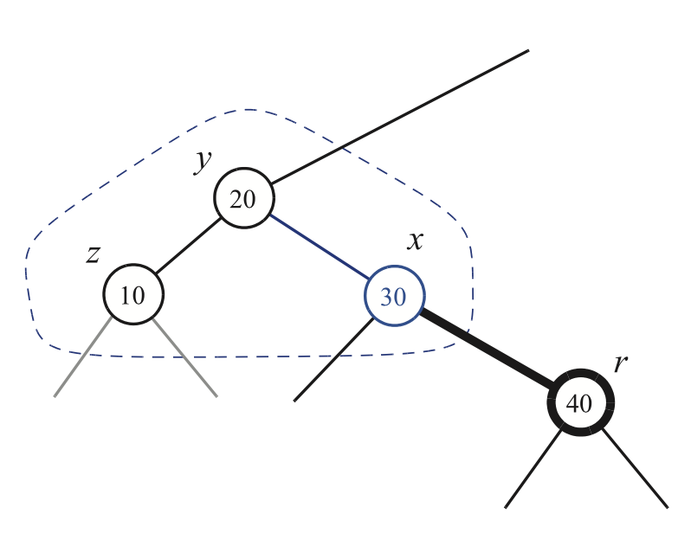
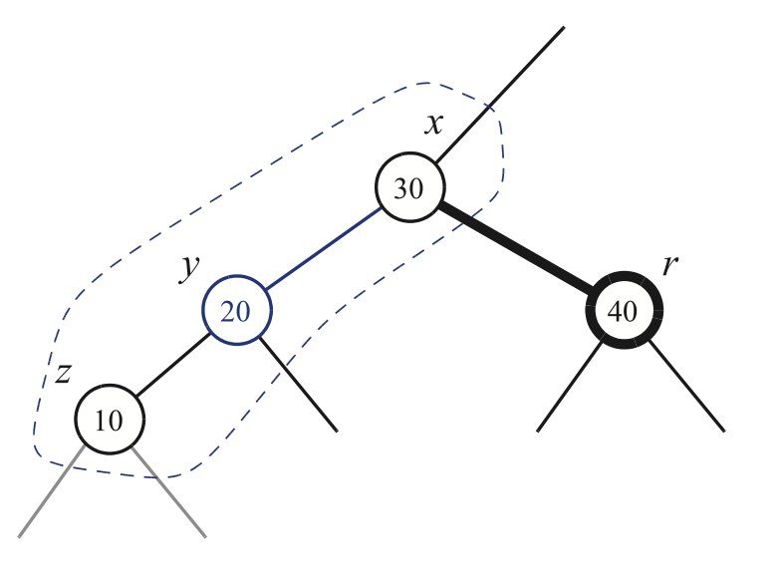
Handling Double Black Nodes: Case 3
Case 3: The sibling y of r is red
We perform adjustment
If y is the right child of x, then let z be the right child of y
If y is the left child of x, then let z be the left child of y
Case 3-1: z is the left child of y
Case 3-2: z is the right child of y → Similarly, we apply
Perform restructuring
Make y be the parent of x
Color y black and x red (double black not yet solved)
→ The sibling of r is black (why?) → Case 1 or Case 2 applies
Notes:
Restructuring 후에도 double black은 해결되지 않았다.

Slide 32
Double Black Node Handling: Summary
The algorithm for remedying a double black node r with sibling y considers three cases
Case 1: y is black and has a red child
We perform a restructuring, and we are done
Case 2: y is black and its children are both black
We perform a recoloring, which may propagate up the double black violation
Case 3: y is red
We perform an adjustment, equivalent to choosing a different representation of a 3-node, after which either Case 1 or Case 2 applies
Deletion in a red-black tree takes O(log n) time

Slide 33
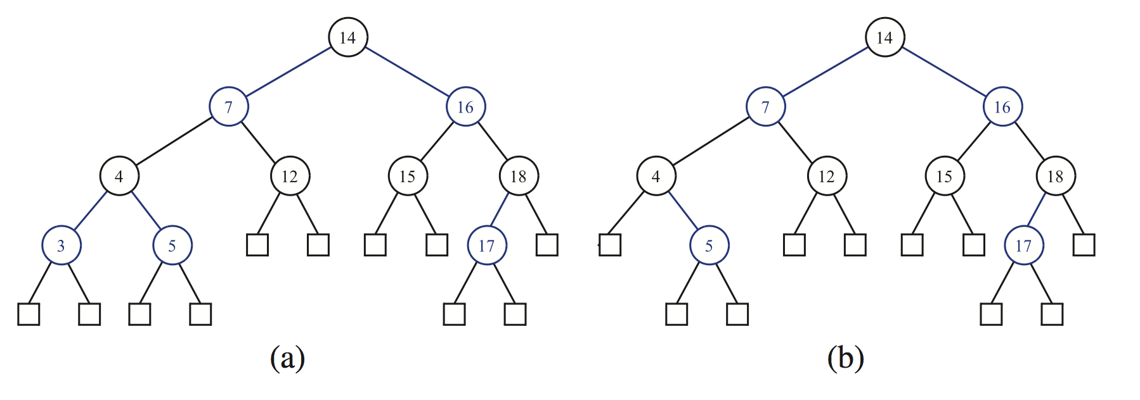
Example: Remove 3
x
v
w
r
r
v is red → Case 0 (either v or r is red)
Remove v and w and color r black

Slide 34
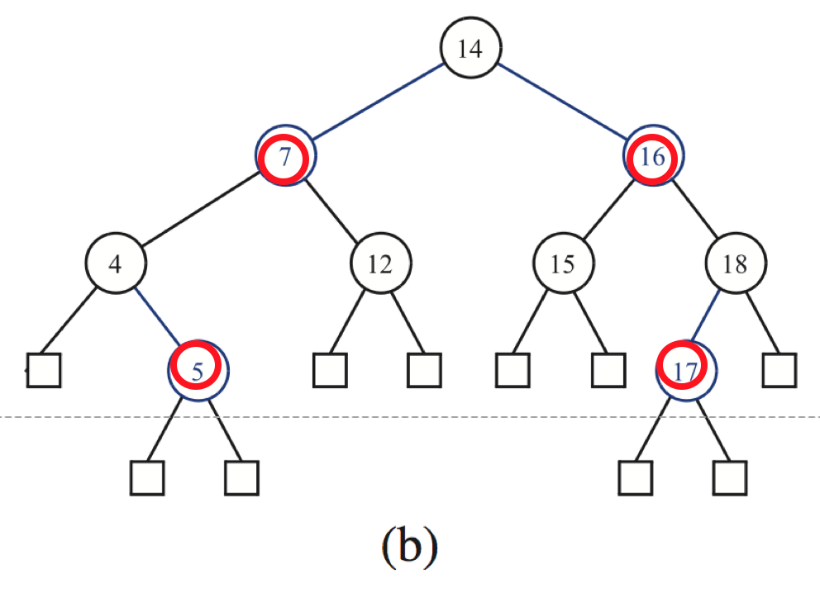
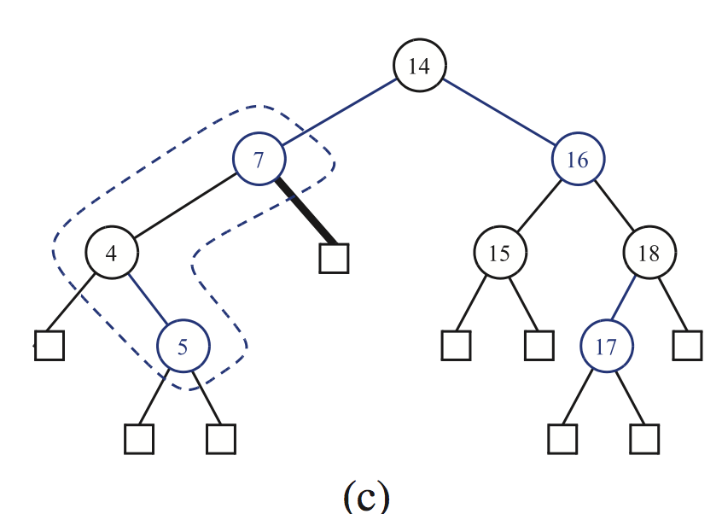
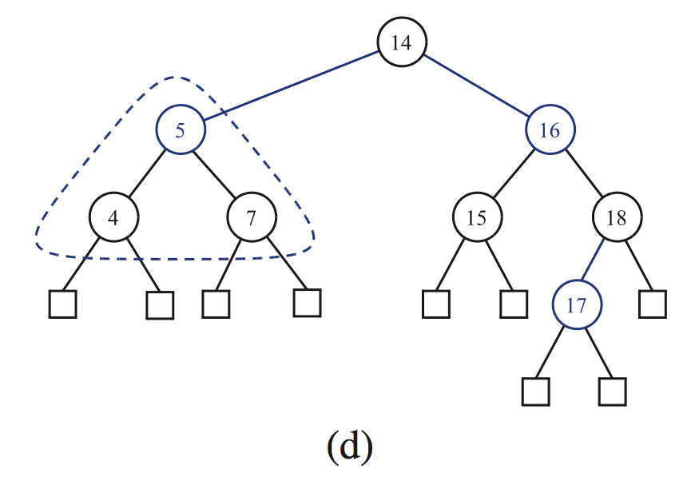
Example: Remove 12
x
x
v
y
w
r
r
z
None of v and r is red → Not Case 0
y is black, which has red child
→ Case 1, restructuring

Slide 35
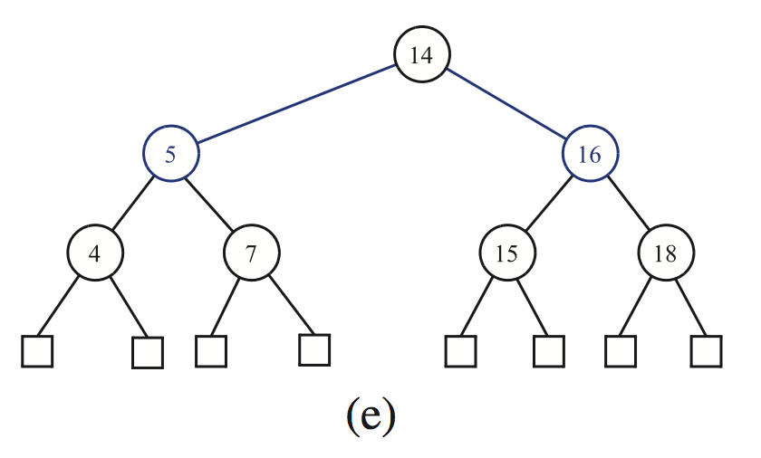
Example: Remove 17
v
v is red →Case 0

Slide 36
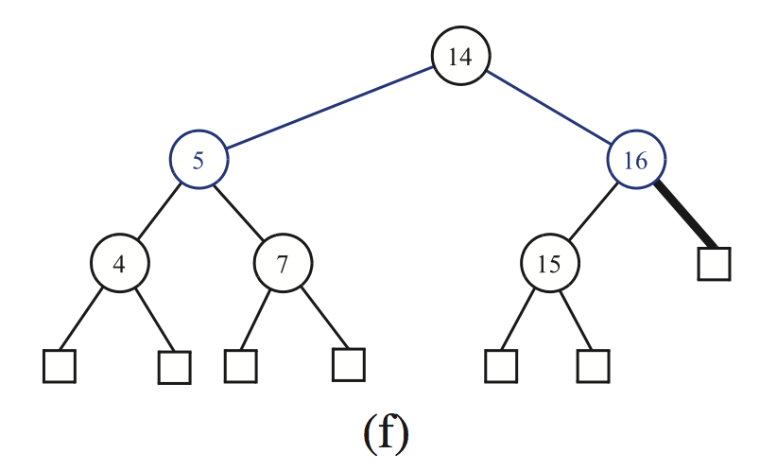
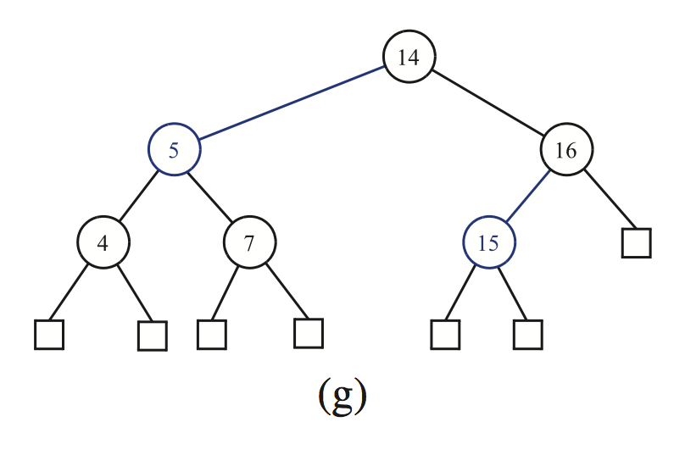
Example: Remove 18
x
x
y
v
y
r
w
r
None of v and r is red → Not Case 0
y is black, having both black children →Case 2
x is red →Case 2-1, recoloring between x and y

Slide 37
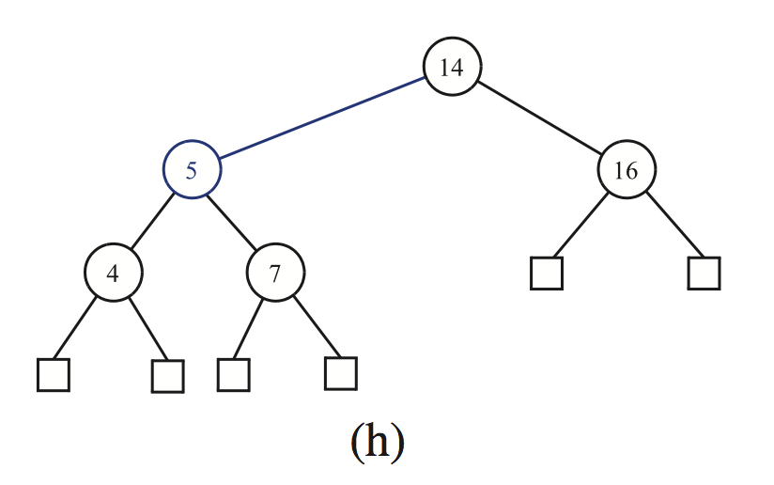
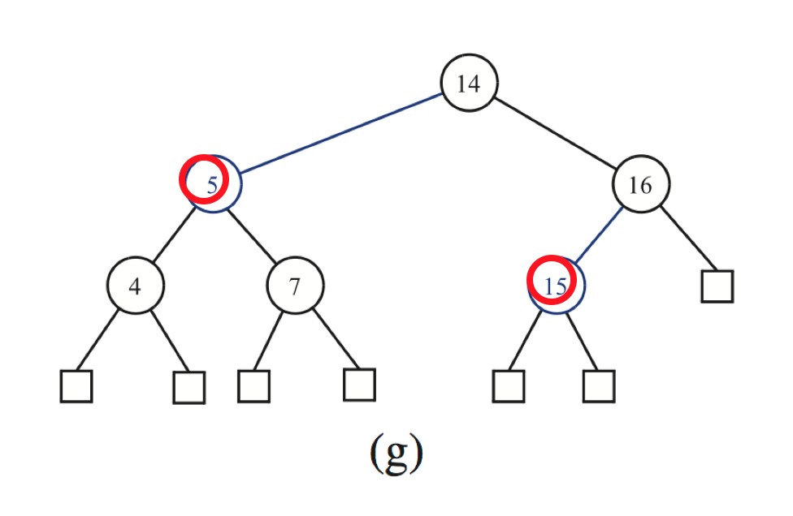
Example: Remove 15
Case 0 (now you know, right?)

Slide 38
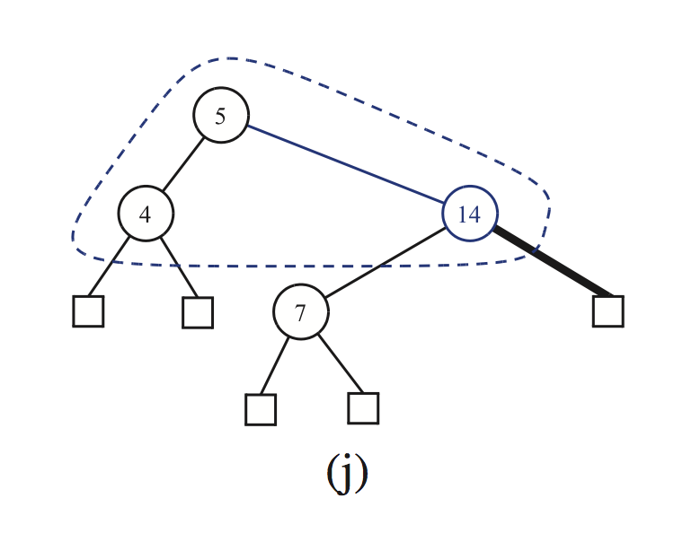
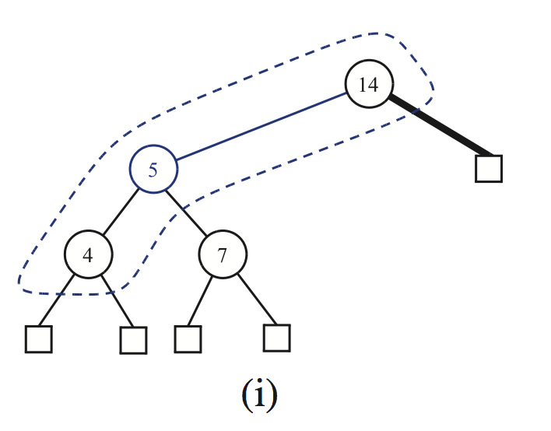
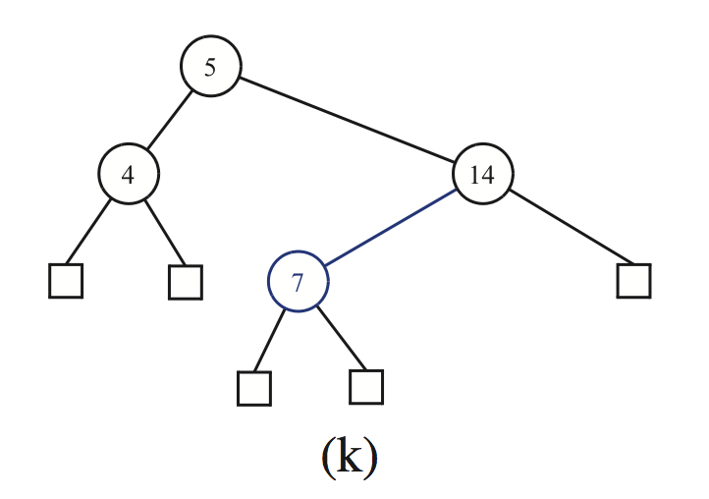
Example: Remove 16
x
y
x
r
z
y
r
y is red → Case 3
y is the left child of x, thus z is node 4 (left child of y) → Case 3-1
Adjustment → node 14 becomes double black → new y (sibling of x)
y has both black children, and x is red
→ Case 2-1, recoloring, then we’re done

